Slide 1
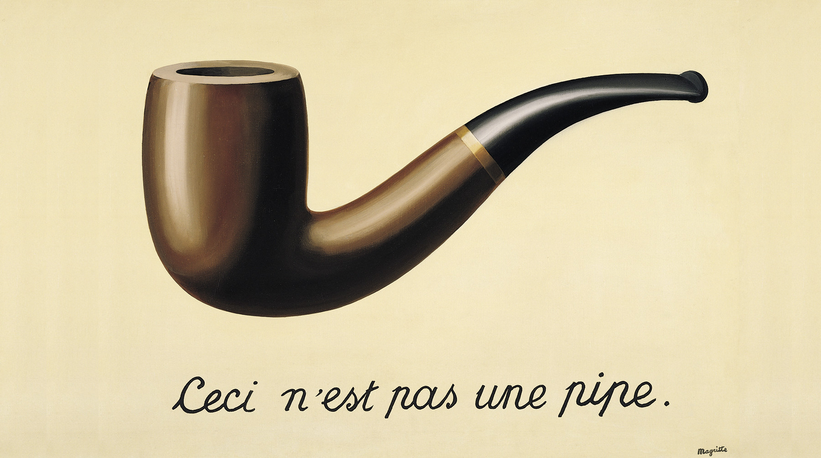
Notes:
The Treachery of Images is a painting by surrealist painter René Magritte.
It is also known as This is Not a Pipe and The Wind and the Song.
The famous pipe. How people reproached me for it! And yet, could you stuff my pipe? No, it's just a representation, is it not? So if I had written on my picture 'This is a pipe', I'd have been lying!
— René Magritte

Slide 2
This is not a pipe
Zoltán Domahidi senior Java developer
HTTP Mocking
and more

Slide 3

There’s no place like 127.0.0.1
HTTP Mocking
Wiremock
Mountebank

Slide 4
There is no place like 127.0.0.1

Slide 5
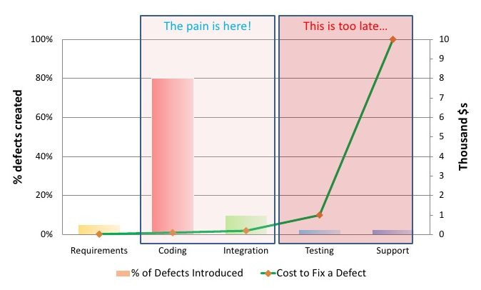

Slide 6

Reasons to stay Home...
cheap
control
fast
easy to set up
independence
Notes:
cheapest:
no servers, no remote environments paid by the customer
you could not create loss when something goes wrong with your app
control:
you have full control
you can bring up/down any service anytime, team-wide coordination not required
fast:
you are not sharing resources with any other users, so your system is fast, not under load
no remote calls
fast and easy debugging
easy to set up:
you don’t need to get permissions or depend on admins
you can update services without maintenance window
you can roll back anytime
independence:
you are immune to other systems development changes/outages
you can work with any version of your dependencies

Slide 7
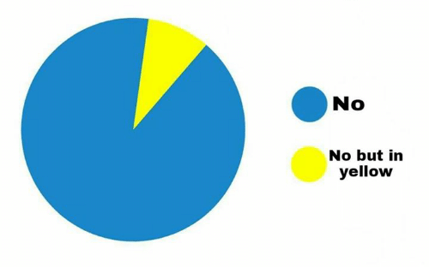
Leaving Home?
No
No but in yellow

Slide 8

...but you have to!
tests are not enough
different versions
different configurations
permissions and authorizations
different operating systems
out-of-date upstream expectations
Notes:
tests are not enough:
they don’t cover everything
it’s hard to simulate exact behaviour
they are many times based on false assumptions
different versions: dependencies might have different versions with different features/compatibilities/issues
different configuration: dependencies might have different configuration
permissions and authorizations: locally everything might work flawlessly and will stop working when you deploy it
different operating systems: it needs different deployment or the dependencies could have some OS specific issues
out-of-date upstream expectations: upstream system might change with time until you develop locally

Slide 9

how to use same versions team/project wide?
how to keep them in sync?
how to stay close to production environment?
how to set up dependencies on each machine?
how to minimize the time and effort?
how to document?
Notes:
everyone should have the same dependency version
it should be updated painlessly as needed
it should stay as close to prod env as possible (versions and configurations)
it takes a lot of time and help to set up dependencies to each team member’s machine
this could take much time and effort
you should create documentation for the newcomers

Slide 10
The answer is...
42

Slide 11
The answer is...
Version Control

Slide 12


Slide 13
Scripts and other text based files could be...
version controlled
used as documentation
shared
easily updated and diffed
branched and merged
automated
used with command-line tools
…and they are lightweight
Notes:
version controlled: if it’s version controlled, it’s easy to track and keep in sync with others
used as documentation: scripts describe a process, descriptor files describe configurations and versions
shared: it’s easy to send someone who does not have access to your version control
easily updated and diffed: git pull to update, and diff against anything to compare; makes it easy to review changes
branched and merged: you can easily manage environment diferencies, or develop without affecting the stable version
automated: automate all the things! (used more than twice)
command-line: grep, sed, ...
lightweight: takes at most some Kbs and not Mbs or Gbs as VM images

Slide 14
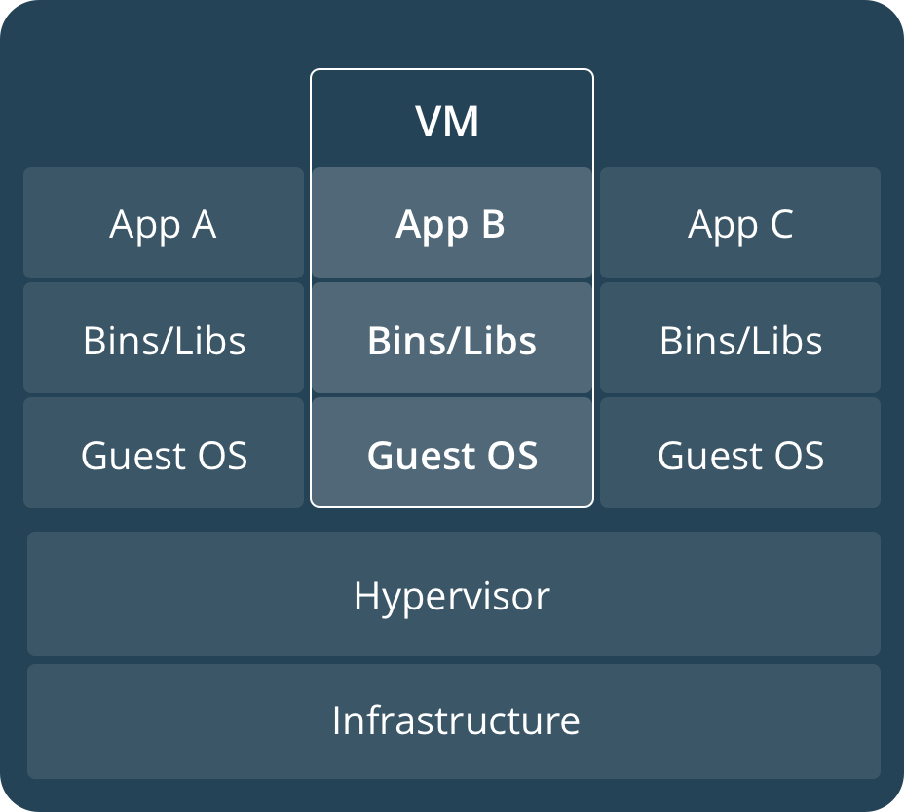
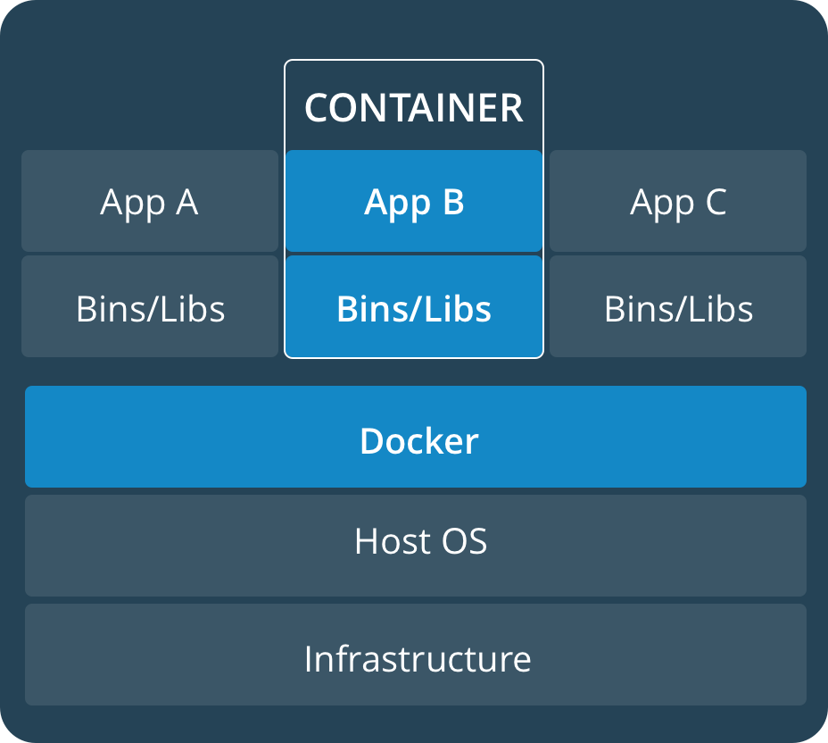
Docker
Notes:
https://docs.docker.com/

Slide 15

Docker
containers
lightweight compared to VMs
don’t need to install applications/services
easy to change versions
easy to run multiple instances
same image runs on Linux/Mac/Win
works on local machine/dev env./CI workflows
use public images or create custom ones using Dockerfile
cattle not pets
Notes:
Containerization is a lightweight alternative to full machine virtualization that involves encapsulating an application in a container with its own operating environment.
https://medium.freecodecamp.org/a-beginner-friendly-introduction-to-containers-vms-and-docker-79a9e3e119b
It gives you more control on your local resources
It is possible to integrate with ComponentTests i.e. with https://www.testcontainers.org/

Slide 16
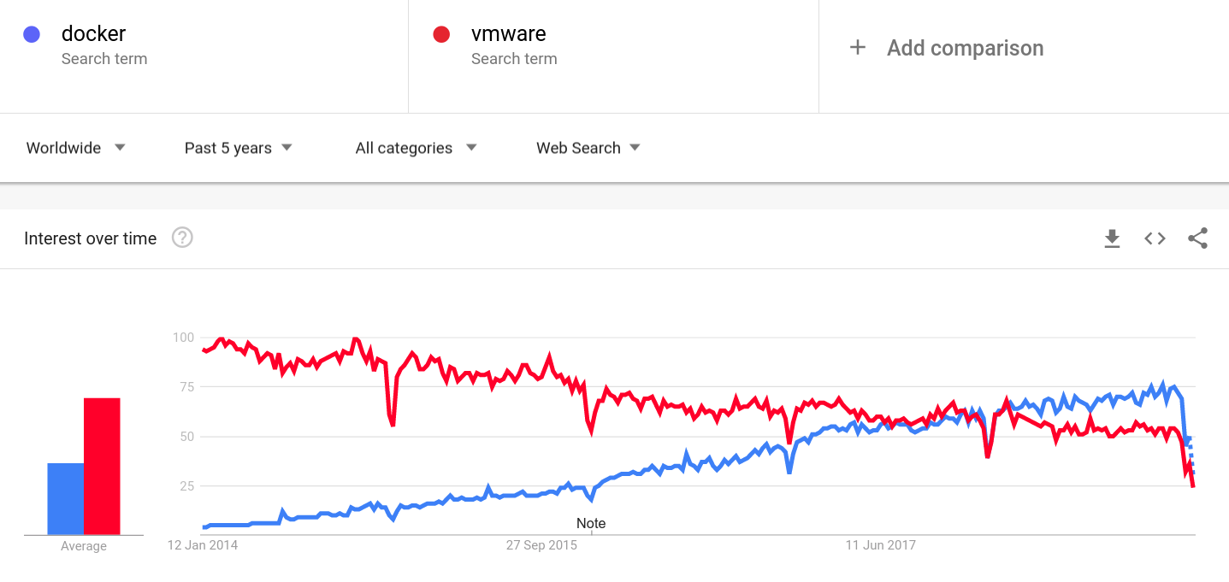
Docker

Slide 17
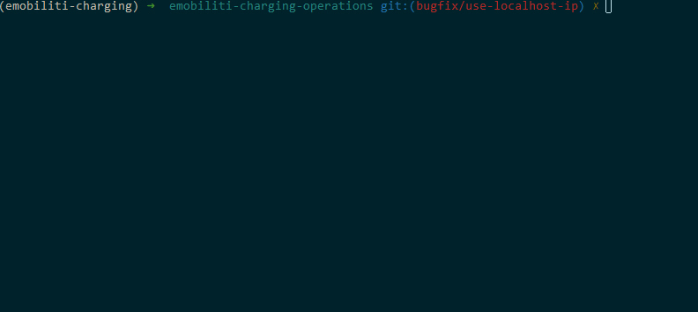
Notes:
Run postgres container
It does not exists on local machine, so Docker pulls down the image
Database is running

Slide 18

Docker Compose
container orchestration
fast and easy
no installers/uninstallers
YAML descriptor:
document application dependencies
easy version update
easy project-wide synchronization
easy diff
Notes:
orchestration: define and manage multiple containers
fast and easy: to install app dependencies
no installers/uninstallers (cattle not pets)
YAML: documenting the dependencies you need for running the application
https://docs.docker.com/compose/

Slide 19
docker-compose.yml
version: '3.6'
services:
db:
image: mysql:${MYSQL_VERSION}
restart: on-failure
container_name: ${SERVICE_NAME}-db
environment:
MYSQL_ROOT_PASSWORD: pass
MYSQL_DATABASE: test-database
ports:
- 3306:3306
volumes:
- ./db/schema.sql:/docker-entrypoint-initdb.d/00_schema.sql
- ./db/data.sql:/docker-entrypoint-initdb.d/01_data.sql
- ./localdata/mysql:/var/lib/mysql
env_file:
- ./.env

Slide 20
docker-compose.yml
version: '3.6'
services:
db:
image: mysql:${MYSQL_VERSION}
restart: on-failure
container_name: ${SERVICE_NAME}-db
environment:
MYSQL_ROOT_PASSWORD: pass
MYSQL_DATABASE: test-database
ports:
- 3306:3306
volumes:
- ./db/schema.sql:/docker-entrypoint-initdb.d/00_schema.sql
- ./db/data.sql:/docker-entrypoint-initdb.d/01_data.sql
- ./localdata/mysql:/var/lib/mysql
env_file:
- ./.env
Notes:
compose version
services
service name

Slide 21
docker-compose.yml
version: '3.6'
services:
db:
image: mysql:${MYSQL_VERSION}
restart: on-failure
container_name: ${SERVICE_NAME}-db
environment:
MYSQL_ROOT_PASSWORD: pass
MYSQL_DATABASE: test-database
ports:
- 3306:3306
volumes:
- ./db/schema.sql:/docker-entrypoint-initdb.d/00_schema.sql
- ./db/data.sql:/docker-entrypoint-initdb.d/01_data.sql
- ./localdata/mysql:/var/lib/mysql
env_file:
- ./.env
Notes:
docker-compose environment variables

Slide 22
docker-compose.yml
version: '3.6'
services:
db:
image: mysql:${MYSQL_VERSION}
restart: on-failure
container_name: ${SERVICE_NAME}-db
environment:
MYSQL_ROOT_PASSWORD: pass
MYSQL_DATABASE: test-database
ports:
- 3306:3306
volumes:
- ./db/schema.sql:/docker-entrypoint-initdb.d/00_schema.sql
- ./db/data.sql:/docker-entrypoint-initdb.d/01_data.sql
- ./localdata/mysql:/var/lib/mysql
env_file:
- ./.env
Notes:
Define image
Restart strategy
Container name
Expose and map ports

Slide 23
docker-compose.yml
version: '3.6'
services:
db:
image: mysql:${MYSQL_VERSION}
restart: on-failure
container_name: ${SERVICE_NAME}-db
environment:
MYSQL_ROOT_PASSWORD: pass
MYSQL_DATABASE: test-database
ports:
- 3306:3306
volumes:
- ./db/schema.sql:/docker-entrypoint-initdb.d/00_schema.sql
- ./db/data.sql:/docker-entrypoint-initdb.d/01_data.sql
- ./localdata/mysql:/var/lib/mysql
env_file:
- ./.env
Notes:
Define environment variables for the application

Slide 24
docker-compose.yml
version: '3.6'
services:
db:
image: mysql:${MYSQL_VERSION}
restart: on-failure
container_name: ${SERVICE_NAME}-db
environment:
MYSQL_ROOT_PASSWORD: pass
MYSQL_DATABASE: test-database
ports:
- 3306:3306
volumes:
- ./db/schema.sql:/docker-entrypoint-initdb.d/00_schema.sql
- ./db/data.sql:/docker-entrypoint-initdb.d/01_data.sql
- ./localdata/mysql:/var/lib/mysql
env_file:
- ./.env
Notes:
Define volumes so you can attach files to the application, or you can persist from it

Slide 25
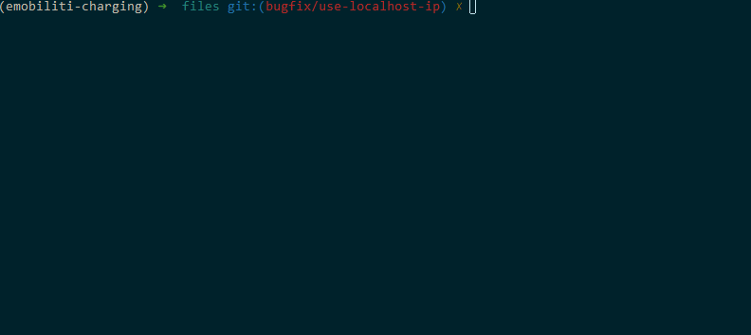
Notes:
See docker compose file
We have db, pubsub, 3 Rest server mocks
No Docker container is running
Start containers in background process
We have 5 Docker container running
Stopping containers
No container is running

Slide 26
Scripts To Rule Them All
script pattern used at GitHub
all projects have the same scripts
contributors can bootstrap the project by knowing only the pattern
the scripts are maintained by the project authors having the knowledge
each script is a unit of work, so they can be called from other scripts
https://github.com/github/scripts-to-rule-them-all
Notes:
In this way the only dependency to set up the local environment is the script runtime environment (usually bash). It could be common project-wide.
These scripts are also documenting the steps how to set up the project, so it could be done manually as well.

Slide 27
Scripts To Rule Them All
script/bootstrap
script/setup
script/update
script/server
script/test
script/cibuild
script/console
install required dependencies
set up an initial state (after clone/reset)
ensure everything is up to date (after a pull)
starts the application (include update)
run tests/test (included in update or cibuild)
used by your CI server
open a console to your application

Slide 28
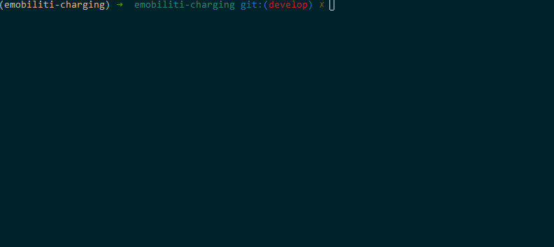
Notes:
No containers running
Rest endpoint not responding
Update project (refresh dependencies)
Containers are already started
Start server
Rest endpoint works now

Slide 29

Now you live in a bubble

Slide 30
HTTP Mocking

Slide 31
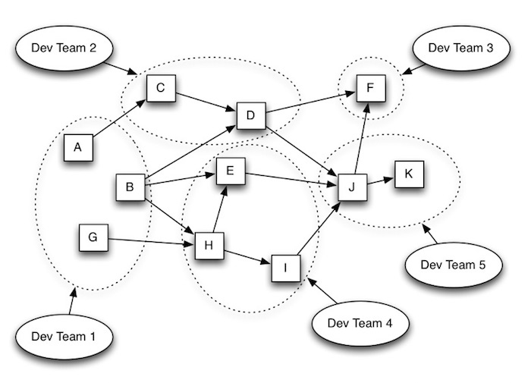
Microservices calling REST APIs
Notes:
Applications calling each other using some HTTP based protocol
In the last couple of years microservices architecture gaining popularity
Microservices mostly communicates via JSON over REST

Slide 32
What this means for developers?
each application calling several others (dependencies)
you need to test HTTP calls:
using remote environment
make a dummy application
write unit tests / contract tests
use HTTP mocking tools:
easy to create simple requests
no language knowledge needed
request verification
extensible
CORS, HTTPS, faults
test library, standalone or docker container
Notes:
Remote env: the easiest but not stable; needs network connection; not possible to write reliable tests
Dummy app: needs to run; need to maintain as an application (dependencies, needs language knowledge); should be used only for complex behaviours or state machine simulations; it becomes a test dependency
Unit tests: not a real http call; it behaves differently (headers missing, cors and secured connection can cause differences); but you have tests

Slide 33
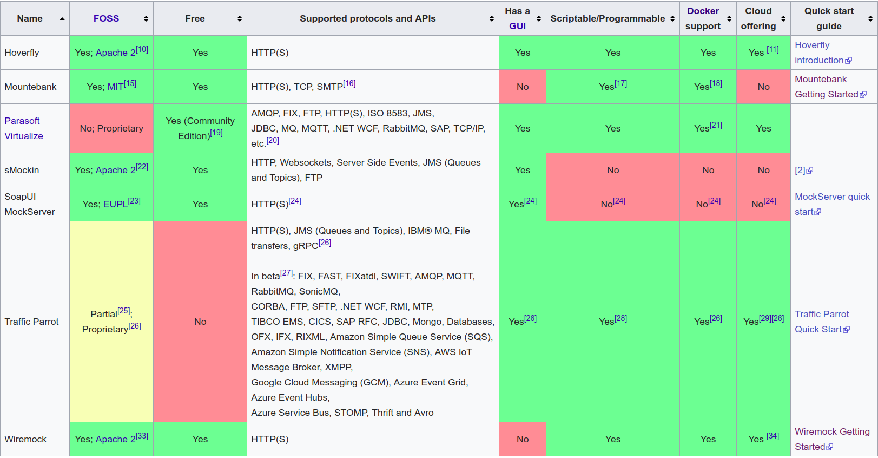
Notes:
https://en.wikipedia.org/wiki/Comparison_of_API_simulation_tools

Slide 34

HTTP testing demo
Notes:
https://github.com/domahidizoltan/presentation-this-is-not-a-pipe/tree/master/demo1-http-testing

Slide 35
Wiremock

Slide 36

Wiremock
Java based HTTP mock server:
clients: PHP, Ruby, Python, Groovy, .NET
stub configuration over REST API or JSON descriptors
extensions and customization writing Java code
build dependency, Junit rule, standalone Java process or docker container
cloud based services (import mocks or swagger definitions, etc)
Notes:
http://wiremock.org/

Slide 37
Wiremock: Features
verify matched, unmatched, near miss and tagged requests
request matchers:
url, headers, query parameters, request body, cookies
operators: equality, regex, contains, json, json path, xml, xpath, absence, etc
response templating (Handlebars):
extract parts of requests, date and time, random values, strings, conditions, etc
faults:
fixed and random delays, chunked dribble delay, bad responses
proxy with record and playback
Notes:
Chunked dribble delay: delay between chunks to simulate slow network

Slide 38
Wiremock: Features
stateful behaviour
HTTPS with certificate verification
customizations:
transforming responses, custom request matchers, post-serve actions, request listeners
Android
Spring Cloud Contract integration
Notes:
Stateful behavior: change the response by state; i.e. GET will have different response if you POSTed something specific before
Customizations: extend with your own code; change responses, make your own request matchers, do actions after response, or listen to specific listeners
It is possible to run on Android
It is possible to generate stubs from Spring Cloud Contracts

Slide 39

Wiremock demo
Notes:
https://github.com/domahidizoltan/presentation-this-is-not-a-pipe/tree/master/demo2-wiremock

Slide 40
Mountebank

Slide 41

Mountebank
Node.JS based HTTP mock server:
clients: Java, Go, JavaScript, TypeScript, PHP, Python, C#, F#, Ruby, Clojure, Delphi, Perl, Shell
also supports TCP and SMTP mocking
build tool integrations:
Grunt, Gradle, Maven
stub configuration over REST API or JSON descriptors
extensions and customization writing JavaScript code (Node.JS, EJS)
build dependency, service or docker container
built in graphical control-pane
imposters
Notes:
http://www.mbtest.org/
Runs as service on any OS (some limitations on Windows)
Imposters: isolated mock endpoints within the Mountebank service

Slide 42
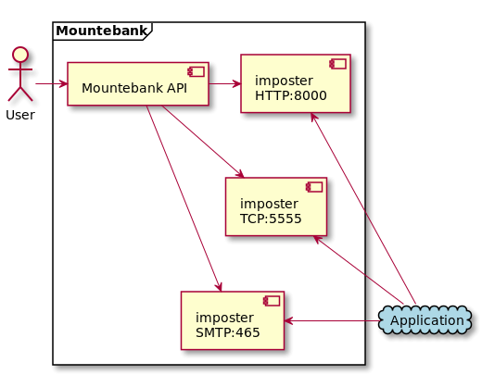
Mountebank: Imposters
Notes:
@startuml
actor :User:
cloud Application #LightBlue
frame "Mountebank" {
component mountebank [
Mountebank API
]
component imposter1 [
imposter
HTTP:8000
]
component imposter2 [
imposter
TCP:5555
]
component imposter3 [
imposter
SMTP:465
]
User -> [mountebank]
[mountebank] -> [imposter1]
[mountebank] --> [imposter2]
[mountebank] ---> [imposter3]
}
[imposter1] <- [Application]
[imposter2] <- [Application]
[imposter3] <- [Application]
@enduml

Slide 43
Mountebank: Features
verify requests
pretty similar matchers (predicates) to WireMock
stub behaviors to post-process responses:
wait, repeat, copy, lookup, decorate, shellTransform
with lookup and shellTransform we can use external datasets
most non-static behaviors requires --allowInjection
circular response arrays
proxy with record and playback
HTTP/HTTPS (with CORS), TCP, SMTP
Notes:
Behaviors: copy some parts of the original response; lookup some data of the response; decorate/alter response with JavaScript injection; shellTransform alters the response by processing using an external command; lookup can use CSV
Proxy is able to simulate the latency of the proxied service. You can decorate responses as well. It can proxy to HTTPS services using certificate

Slide 44

Mountebank demo
Notes:
https://github.com/domahidizoltan/presentation-this-is-not-a-pipe/tree/master/demo3-mountebank

Slide 45
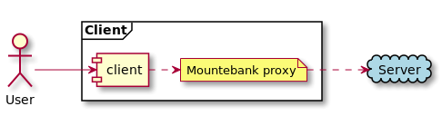
Mountebank demo
Notes:
@startuml
actor :User:
cloud Server #LightBlue
frame Client {
User -> [client] :" "
note "Mountebank proxy" as proxy
}
(client) .right.> proxy
proxy .right.> (Server) :" "
@enduml

Slide 46

State machine demo
Notes:
https://github.com/domahidizoltan/presentation-this-is-not-a-pipe/tree/master/demo4-statemachine

Slide 47
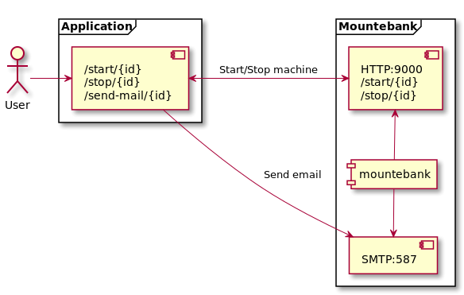
State machine demo
Notes:
@startuml
actor :User:
frame Application {
component endpoints [
/start/{id}
/stop/{id}
/send-mail/{id}
]
}
frame Mountebank {
component mountebank
component startStopImposter [
HTTP:9000
/start/{id}
/stop/{id}
]
component mailImposter [
SMTP:587
]
[startStopImposter] <-down- [mountebank]
[mailImposter] <-up- [mountebank]
}
User -> [endpoints] : " "
[endpoints] <-> [startStopImposter] : " Start/Stop machine "
[endpoints] -> [mailImposter] : "Send email "
@enduml

Slide 48
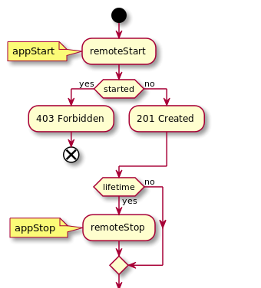
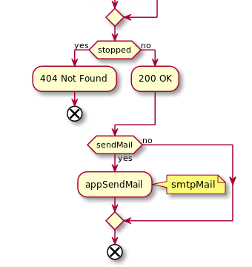
State machine demo
Notes:
@startuml
start
:remoteStart;
note
appStart
end note
if (started) then (yes)
:403 Forbidden;
end
else (no)
:201 Created;
endif
if (lifetime) then (yes)
:remoteStop;
note
appStop
end note
else (no)
endif
if (stopped) then (yes)
:404 Not Found;
end
else (no)
:200 OK;
endif
if (sendMail) then (yes)
:appSendMail;
note right
smtpMail
end note
else (no)
endif
end
@enduml

Slide 49

Swagger bank demo
Notes:
https://github.com/Tzinov15/swagger-bank
https://editor.swagger.io/
https://github.com/domahidizoltan/presentation-this-is-not-a-pipe/tree/master/demo5-swagger-bank

Slide 50
Resources
MockServer
Comparison of API simulation tools
Docker
Docker Compose
Scripts to rule them all
WireMock
Mountebank
Demo: https://github.com/domahidizoltan/presentation-this-is-not-a-pipe

Slide 51

Thank you!

